Slide 1
MACHINE LEARNING
IN FINANCE
Lecture 4 | Feature Engineering for Financial Data
From financial behaviour to leakage-safe predictors
04
Dr Ferdinantos Kottas
NKUA MPhil Economics | Academic Year 2026–2027
Machine Learning in Finance · Week 04 · NKUA MPhil Economics · 2026–2027
01
Notes:
Analytical comment for students: Feature engineering. The objective is to represent financial behaviour in variables that a supervised model can use at a defined prediction point. The feature must represent information available at the prediction point and must be reproducible for future observations. Common mistake: Do not create a feature merely because it is easy to calculate.

Slide 2
LECTURE QUESTION
Which financial behaviours should become model inputs?
A raw amount, a ratio, a change, and a recent event describe different parts of the same account.
LEVEL
CAPACITY
EVENT
How large is the account balance or payment?
How large is the balance relative to the credit limit?
Did a recent overdue status or sharp change occur?
Feature engineering is the translation from a financial question to a reproducible variable.
Machine Learning in Finance · Week 04 · NKUA MPhil Economics · 2026–2027
02
Notes:
Analytical comment for students: Lecture question. The choice of representation changes what the model can learn. A raw balance cannot directly express capacity pressure unless the denominator is also considered. The feature must represent information available at the prediction point and must be reproducible for future observations. Common mistake: Do not create a feature merely because it is easy to calculate.

Slide 3
LEARNING OBJECTIVES
Required outcomes for Week 4
Each outcome links a feature calculation to a financial interpretation.
Define the observation unit, target, horizon, and information cutoff before calculating a feature.
Distinguish a data-driven event from a target-driven event.
Construct ratios, counts, changes, lags, rolling summaries, indicators, and interactions.
Select features with filter, wrapper, embedded, and stability-based techniques.
Assess distribution stability, relationship stability, and operational availability.
Document formulas, units, raw inputs, timing, missingness, and evidence.
Machine Learning in Finance · Week 04 · NKUA MPhil Economics · 2026–2027
03
Notes:
Analytical comment for students: Learning objectives. A feature is complete only when its financial meaning, timing, and validation evidence agree. The feature must represent information available at the prediction point and must be reproducible for future observations. Common mistake: Do not create a feature merely because it is easy to calculate.

Slide 4
DATASET
The empirical case uses a real credit-risk table
The source is the UCI Default of Credit Card Clients dataset.
Item | Definition
Source | UCI Machine Learning Repository, dataset 350
Rows and raw columns | 30,000 observations and 25 raw columns
Observation unit | One credit-card client at the reporting snapshot
Target | default_next_month: 1 = default, 0 = no default
Default rate | 22.1%
Currency convention | Source monetary amounts are in New Taiwan dollars
Machine Learning in Finance · Week 04 · NKUA MPhil Economics · 2026–2027
04
Notes:
Analytical comment for students: The UCI source is a cross-sectional teaching dataset with six months of history encoded in columns. It is suitable for demonstrating feature construction, but it does not support a true temporal drift study without additional timestamps. Source: https://archive.ics.uci.edu/dataset/350/default+of+credit+card+clients.

Slide 5
TARGET BALANCE
The target is imbalanced before any feature is constructed
The baseline prevalence is the reference point for every later target-rate comparison.
NON-DEFAULT
23,364 accounts, 77.9% of the sample.
DEFAULT
6,636 accounts, 22.1% of the sample.
Machine Learning in Finance · Week 04 · NKUA MPhil Economics · 2026–2027
05
Notes:
Analytical comment for students: Target balance. A subgroup rate must be interpreted with its number of accounts and compared with the overall prevalence. A high rate in a tiny group can be unstable. The feature must represent information available at the prediction point and must be reproducible for future observations. Common mistake: Do not create a feature merely because it is easy to calculate.

Slide 6
OBSERVATION UNIT
One row represents one client at a reporting snapshot
The grouping key controls every lag, rolling function, aggregation, and split.
ACCOUNT-LEVEL ROW
DIFFERENT ROW, DIFFERENT RULE
LIMIT_BAL, BILL_AMT1, PAY_AMT1, and PAY_0 describe one client at the snapshot. The target is observed in the following month.
A transaction row, account-month row, and borrower row require different aggregation and validation rules.
ANALYTICAL CHECK
Before a rolling calculation, state the entity key, the time order, and the number of observations in the window.
Machine Learning in Finance · Week 04 · NKUA MPhil Economics · 2026–2027
06
Notes:
Analytical comment for students: Observation unit. A feature such as average payment is incomplete until the population and time window are explicit. The feature must represent information available at the prediction point and must be reproducible for future observations. Common mistake: Do not create a feature merely because it is easy to calculate.

Slide 7
PREDICTION POINT
The prediction point determines the valid information set
For credit risk, the model predicts a future outcome using information available at the snapshot.
t−6
t−1
t
t+1
lookback
recent history
decision
target
VALIDITY RULE
A payment posted before t can enter a feature at t. A payment posted after t belongs to a later information set.
Machine Learning in Finance · Week 04 · NKUA MPhil Economics · 2026–2027
07
Notes:
Analytical comment for students: Prediction point. The same column can be valid or invalid depending on when the prediction is made. This is the central control against look-ahead bias. The feature must represent information available at the prediction point and must be reproducible for future observations. Common mistake: Do not create a feature merely because it is easy to calculate.

Slide 8
FEATURE CONTRACT
Every feature needs a written contract
The contract makes the variable reviewable before it enters a model.
Contract field | Example: utilization
Name | utilization
Formula | BILL_AMT1 / LIMIT_BAL
Raw inputs | BILL_AMT1 and LIMIT_BAL
Unit | Ratio
Timing | Available at the reporting snapshot
Zero and missing policy | Zero limit becomes missing; affected rows are counted
Validation evidence | Distribution, bands, stability, and leakage check
Machine Learning in Finance · Week 04 · NKUA MPhil Economics · 2026–2027
08
Notes:
Analytical comment for students: Feature contract. A column name is not a definition. The contract records what the feature means, when it is available, and how it behaves in exceptional cases. The feature must represent information available at the prediction point and must be reproducible for future observations. Common mistake: Do not create a feature merely because it is easy to calculate.

Slide 9
PART 1
Events, targets, and information timing
09
The model input and the model outcome are different kinds of events.
Machine Learning in Finance
09
Notes:
Analytical comment for students: Events, targets, and information timing. The model input and the model outcome are different kinds of events. The feature must represent information available at the prediction point and must be reproducible for future observations. Common mistake: Do not create a feature merely because it is easy to calculate.

Slide 10
EVENT TAXONOMY
Two event clocks govern the modelling problem
The input is known when the decision is made; the target is known only after the outcome window closes.
AT THE PREDICTION POINT T
Xₜ: observed inputs
feature logic
decision / score
AFTER THE OUTCOME WINDOW
Yₜ₊₁: target
bad / good label
monitor rate
1
DATA-DRIVEN
2
TARGET-DRIVEN
3
MONITORING
A change or threshold in X that is observable by t. It may define a current feature.
An outcome or target-rate change observed after t. It is never an input for the original prediction.
A later comparison of input distributions, target rates, or feature–target relationships.
Machine Learning in Finance · Week 04 · NKUA MPhil Economics · 2026–2027
10
Notes:
Analytical comment for students: Event taxonomy. A data-driven event is part of the information set if it is available by the prediction point. A target-driven event is the future label or a later target-rate movement. Monitoring events compare samples after the fact. The timeline is the control that keeps feature construction separate from outcome analysis. The feature must represent information available at the prediction point and must be reproducible for future observations. Common mistake: Do not create a feature merely because it is easy to calculate.

Slide 11
DATA-DRIVEN EVENT
A data-driven event is a current observable state or change
It can become a predictor because it can be reproduced for a new account at the same decision time.
DEFINITION
Eₜ(X) = 𝟙{g(Xₜ, Xₜ₋₁, …) crosses a stated threshold}
RAW INPUTS
DERIVED STATE
EVENT FLAG
USE AT T
BILL_AMT1 = 80,000
LIMIT_BAL = 100,000
→
utilizationₜ = 0.80
→
high_utilizationₜ = 𝟙{utilizationₜ ≥ 0.80}
→
available before
default_next_month
INTERPRETATION
The event is not “the customer defaulted.” It is “the observed account state crossed a rule at t.” The threshold can be a policy cut or a training-only cut, but it must be documented and available at scoring time.
Machine Learning in Finance · Week 04 · NKUA MPhil Economics · 2026–2027
11
Notes:
Analytical comment for students: Data-driven event. The event should be computable for a new account before the target is known. In the example, 80,000 divided by 100,000 gives utilization 0.80, so the current high-utilization flag is one when the rule is greater than or equal to 0.80. The future default label is deliberately not used to create the flag. The feature must represent information available at the prediction point and must be reproducible for future observations. Common mistake: Do not create a feature merely because it is easy to calculate.

Slide 12
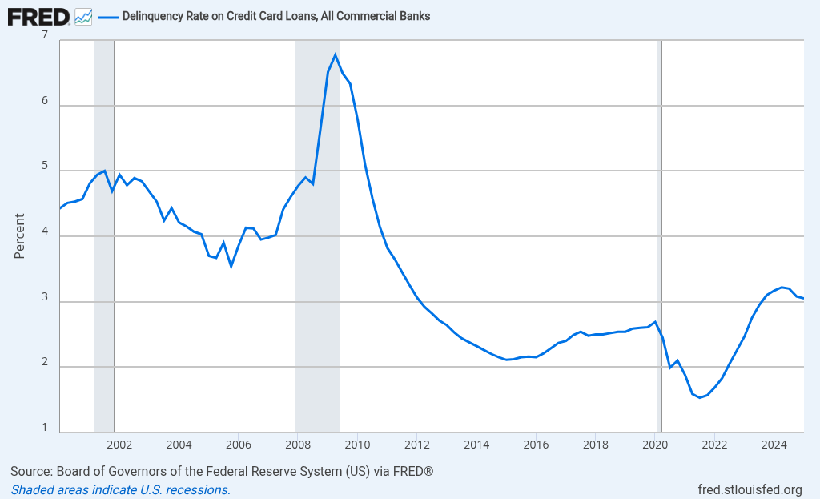
TARGET-DRIVEN EVENT
A target-driven event is observed after the prediction point
It is the outcome we want to predict or a later movement in the outcome rate. It can explain a problem to investigate, but it cannot be used as an input at t.
BAD-RATE MATHEMATICS
BRₘ = Bₘ / Nₘ and ΔBRₘ = BRₘ − BRₘ₋₁
Bₘ is the number of observed bad outcomes; Nₘ is the eligible population with mature labels.
TARGET EXAMPLE
default_next_month = 1 is observed after t. The label closes only after the outcome window and censoring rule are complete.
EVENT WINDOWS TO INVESTIGATE
Financial crisis: 2008–09. Pandemic shock: 2020. War or energy shock: from February 2022. Compare rates and denominators across windows; coincidence is not causality.
Machine Learning in Finance · Week 04 · NKUA MPhil Economics · 2026–2027
12
Notes:
Analytical comment for students: Target-driven event. A target-driven event is a later outcome or a later target-rate movement. The bad rate BRₘ is observed bad outcomes divided by the eligible mature population. The FRED figure provides a real credit-delinquency series with recession context; the windows are hypotheses for investigation, not causal proof. Source: Board of Governors of the Federal Reserve System, Delinquency Rate on Credit Card Loans, All Commercial Banks, FRED series DRCCLACBS, https://fred.stlouisfed.org/series/DRCCLACBS. The feature must represent information available at the prediction point and must be reproducible for future observations. Common mistake: Do not create a feature merely because it is easy to calculate.

Slide 13
EVENT TIMELINE
The event must be placed on the timeline
The same account can generate a data-driven event at t and a target-driven event at t+1.
t−1
t
t+1
t+2
bill and payment history
data-driven event
target-driven event
later monitoring
RULE
At t, the model can use the event at t and the history before t. It cannot use the event at t+1 when predicting t+1.
Machine Learning in Finance · Week 04 · NKUA MPhil Economics · 2026–2027
13
Notes:
Analytical comment for students: Event timeline. This separation is the simplest way to explain why a future target can be correlated with a current feature without being allowed inside its construction. The feature must represent information available at the prediction point and must be reproducible for future observations. Common mistake: Do not create a feature merely because it is easy to calculate.

Slide 14
EVENT CODE
The code should make the event definition visible
Explicit components make the event auditable and reusable.
PYTHON
OUTPUT
credit['utilization'] = (
credit['BILL_AMT1']
/ credit['LIMIT_BAL'].replace(0, np.nan)
)
credit['high_utilization'] = (
credit['utilization'] >= 0.80
).astype(int)
credit['recent_overdue'] = (
credit['PAY_0'] > 0
).astype(int)
high_utilization = 1: 7,980
recent_overdue = 1: 6,818
The raw ratio and status
remain available for audit.
Machine Learning in Finance · Week 04 · NKUA MPhil Economics · 2026–2027
14
Notes:
Analytical comment for students: Event code. The code separates the continuous measurement from the binary event. Keeping both allows the model and analyst to test whether thresholding discards useful information. The feature must represent information available at the prediction point and must be reproducible for future observations. Common mistake: Do not create a feature merely because it is easy to calculate.

Slide 15
EVENT STATES
Observed event states separate default rates in the UCI data
This chart shows a target-driven comparison after defining data-driven states.
LOWEST RATE
13.1% across 17,343 accounts when both events are absent.
JOINT STATE
56.2% across 2,141 accounts when both events are present.
Machine Learning in Finance · Week 04 · NKUA MPhil Economics · 2026–2027
15
Notes:
Analytical comment for students: Event states. The target rate is shown after the data-driven states are defined. The chart supports an association statement. It does not prove that either event causes default. The feature must represent information available at the prediction point and must be reproducible for future observations. Common mistake: Do not create a feature merely because it is easy to calculate.

Slide 16
TARGET DESIGN
The target is future information
A one-month credit-risk target uses the account state at t and the outcome after t.
At prediction point t | Future target window t+1
Current limit and bill | Default during the following month
Repayment status through t | No default during the following month
Payment information posted by t | Target is withheld from feature construction
LEAKAGE WARNING
A field created after default entry, collection action, or a future payment belongs to the target period and cannot define the current predictor.
Machine Learning in Finance · Week 04 · NKUA MPhil Economics · 2026–2027
16
Notes:
Analytical comment for students: Target design. The target window determines the valid feature window. A target is not simply another column in the table. The feature must represent information available at the prediction point and must be reproducible for future observations. Common mistake: Do not create a feature merely because it is easy to calculate.

Slide 17
PART 2
Ratios and transformations
17
Ratios, counts, and transformations expose financial structure that raw levels hide.
Machine Learning in Finance
17
Notes:
Analytical comment for students: Ratios and transformations. Ratios, counts, and transformations expose financial structure that raw levels hide. The feature must represent information available at the prediction point and must be reproducible for future observations. Common mistake: Do not create a feature merely because it is easy to calculate.

Slide 18
RATIOS
Ratios compare exposure with a reference scale
A ratio can make accounts comparable when raw amounts have different economic meanings.
CORE EXAMPLE
utilizationᵢ = BILL_AMT1ᵢ / LIMIT_BALᵢ, when LIMIT_BALᵢ ≠ 0
FINANCIAL QUESTION
DATA QUESTION
Is the current bill large relative to the credit capacity available to this account?
What happens when the denominator is zero, missing, or extremely small?
Machine Learning in Finance · Week 04 · NKUA MPhil Economics · 2026–2027
18
Notes:
Analytical comment for students: Ratios. A ratio changes the unit and the comparison. It does not remove the need to check the numerator, denominator, and timing. The feature must represent information available at the prediction point and must be reproducible for future observations. Common mistake: Do not create a feature merely because it is easy to calculate.

Slide 19
UTILIZATION
Utilization measures current capacity pressure
The same bill amount can imply different pressure for accounts with different credit limits.
PYTHON
OUTPUT
credit['utilization'] = (
credit['BILL_AMT1']
/ credit['LIMIT_BAL'].replace(0, np.nan)
)
BILL_AMT1 LIMIT_BAL utilization
46,990 50,000 0.940
20,000 120,000 0.167
90,000 90,000 1.000
unit: ratio
Machine Learning in Finance · Week 04 · NKUA MPhil Economics · 2026–2027
19
Notes:
Analytical comment for students: Utilization. The ratio is easier to compare across accounts than the bill amount alone. Values above 1 indicate the billed amount exceeds the recorded limit in the source snapshot. The feature must represent information available at the prediction point and must be reproducible for future observations. Common mistake: Do not create a feature merely because it is easy to calculate.

Slide 20
UTILIZATION EVIDENCE
Utilization bands show an interpretable pattern
The relationship is descriptive and should be tested out of sample later.
LOWEST BAND
18.3% across 14,037 accounts.
ABOVE LIMIT
30.1% across 2,123 accounts.
Machine Learning in Finance · Week 04 · NKUA MPhil Economics · 2026–2027
20
Notes:
Analytical comment for students: Utilization evidence. The band comparison suggests that high utilization may contain predictive information. It does not prove a monotonic relationship or a causal effect. The feature must represent information available at the prediction point and must be reproducible for future observations. Common mistake: Do not create a feature merely because it is easy to calculate.

Slide 21
PAYMENT CAPACITY
Payment-to-bill ratio measures repayment relative to billed exposure
It describes a different financial mechanism from utilization.
CORE EXAMPLE
payment_to_billᵢ = total_paid_6mᵢ / total_bill_6mᵢ, when total_bill_6mᵢ ≠ 0
UTILIZATION
PAYMENT-TO-BILL
Bill relative to credit limit. It measures use of capacity.
Payment relative to billed amount. It measures repayment relative to exposure.
Machine Learning in Finance · Week 04 · NKUA MPhil Economics · 2026–2027
21
Notes:
Analytical comment for students: Payment capacity. Two ratios can both be valid because they answer different questions. Removing one because it is correlated with another should be a validated selection decision. The feature must represent information available at the prediction point and must be reproducible for future observations. Common mistake: Do not create a feature merely because it is easy to calculate.

Slide 22
PAYMENT CAPACITY EVIDENCE
Payment-to-bill bands do not form a simple straight line
The lowest repayment bands show higher observed default rates in this sample, but the relationship is not perfectly monotonic.
0–5% PAYMENT
27.1% across 9,903 accounts.
25–50% PAYMENT
14.4% across 2,558 accounts.
Machine Learning in Finance · Week 04 · NKUA MPhil Economics · 2026–2027
22
Notes:
Analytical comment for students: Payment capacity evidence. Binning helps students inspect shape, but a binned relationship can conceal within-bin variation. Later models may use a continuous ratio, bins, or both after validation. The feature must represent information available at the prediction point and must be reproducible for future observations. Common mistake: Do not create a feature merely because it is easy to calculate.

Slide 23
DENOMINATOR SAFETY
A ratio is incomplete without a denominator policy
Zero denominators and extreme ratios can create NaN, infinity, or an unstable tail.
Condition | Safe policy | Evidence to report
Denominator = 0 | Set ratio to missing or use a documented business rule | Number of affected rows
Denominator missing | Keep missing and impute inside the training pipeline | Missingness rate
Denominator near zero | Review whether the ratio remains meaningful | Tail count and threshold
Negative denominator | Check source meaning before calculating | Rows and source definition
INTERPRETATION
A missing ratio is information about the calculation boundary. It should not silently become zero.
Machine Learning in Finance · Week 04 · NKUA MPhil Economics · 2026–2027
23
Notes:
Analytical comment for students: Denominator safety. The numerical policy is part of the economic definition. A ratio created with an invalid denominator can look precise while being meaningless. The feature must represent information available at the prediction point and must be reproducible for future observations. Common mistake: Do not create a feature merely because it is easy to calculate.

Slide 24
COUNTS AND SEVERITY
Counts, maximums, and indicators preserve different information
Frequency, worst observed status, and threshold crossing are not interchangeable.
Feature | Question | Example
overdue_count_6m | How often did overdue status appear? | 3 of 6 status observations
max_delay_6m | What was the worst status? | Maximum ordered status code
recent_overdue | Is the latest status overdue? | PAY_0 > 0
any_overdue_6m | Did it happen at least once? | count > 0
Machine Learning in Finance · Week 04 · NKUA MPhil Economics · 2026–2027
24
Notes:
Analytical comment for students: Counts and severity. The correct summary depends on the mechanism. A single recent event may matter more than an old repeated event, while a maximum may represent stress severity. The feature must represent information available at the prediction point and must be reproducible for future observations. Common mistake: Do not create a feature merely because it is easy to calculate.

Slide 25
OVERDUE COUNT
Repeated overdue status has a strong descriptive separation
The observed rate rises with the number of overdue status fields in this sample.
NO OVERDUE STATUS
11.7% across 19,931 accounts.
SIX OVERDUE STATUSES
70.3% across 1,341 accounts.
Machine Learning in Finance · Week 04 · NKUA MPhil Economics · 2026–2027
25
Notes:
Analytical comment for students: Overdue count. The chart is a target-rate diagnostic, not a causal estimate. The status-code meaning and the number of accounts in each group must be checked. The feature must represent information available at the prediction point and must be reproducible for future observations. Common mistake: Do not create a feature merely because it is easy to calculate.

Slide 26
COUNT CODE
A count turns repeated status fields into an intensity measure
The indicator function makes the rule visible.
PYTHON
OUTPUT
status_cols = ['PAY_0', 'PAY_2', 'PAY_3',
'PAY_4', 'PAY_5', 'PAY_6']
credit['overdue_count_6m'] = (
credit[status_cols] > 0
).sum(axis=1)
mean count: 0.834
0 overdue months: 19,931
6 overdue months: 1,341
maximum possible: 6
Machine Learning in Finance · Week 04 · NKUA MPhil Economics · 2026–2027
26
Notes:
Analytical comment for students: Count code. The count is a summary of six fields. It should be retained with the raw status variables until a validated model and documentation justify a different representation. The feature must represent information available at the prediction point and must be reproducible for future observations. Common mistake: Do not create a feature merely because it is easy to calculate.

Slide 27
CHANGES
A change feature captures movement rather than level
Two accounts with the same current bill can have different recent trajectories.
CORE EXAMPLE
Δxₜ = xₜ − xₜ₋₁
BILL CHANGE
PAYMENT CHANGE
BILL_AMT1 − BILL_AMT2 measures the recent movement in billed exposure.
PAY_AMT1 − PAY_AMT2 measures the recent movement in recorded repayment.
Machine Learning in Finance · Week 04 · NKUA MPhil Economics · 2026–2027
27
Notes:
Analytical comment for students: Changes. The sign carries information. A positive bill change and a negative payment change do not have the same financial interpretation as their opposites. The feature must represent information available at the prediction point and must be reproducible for future observations. Common mistake: Do not create a feature merely because it is easy to calculate.

Slide 28
CHANGE EVIDENCE
Recent bill movement has both positive and negative tails
The mean alone is not enough to describe a change variable.
Statistic | bill_change_1m | Interpretation
Mean | 2044 | Average recent bill movement
25th percentile | -51708 | Lower-tail movement
Median | 0 | Middle observation
75th percentile | 78807 | Upper-tail movement
FINANCIAL READING
A difference retains direction. A magnitude-only transformation would answer a different question about absolute movement.
Machine Learning in Finance · Week 04 · NKUA MPhil Economics · 2026–2027
28
Notes:
Analytical comment for students: Change evidence. Change variables can be skewed and can mix account size with movement. Consider both a raw difference and a relative or signed-log representation. The feature must represent information available at the prediction point and must be reproducible for future observations. Common mistake: Do not create a feature merely because it is easy to calculate.

Slide 29
LOG TRANSFORMATION
Use log1p to compress a positive monetary amount
The logarithm is not an addition. The code and the mathematical definition must say the same thing.
CORRECT DEFINITION
log1p(xᵢ) = ln(1 + xᵢ)
Domain for a real-valued result: xᵢ > −1. For a non-negative amount, this condition is automatically satisfied.
Input xᵢ | Correct transformed value | Financial reading
0 | ln(1 + 0) = 0 | Zero remains zero
99 | ln(1 + 99) = ln(100) ≈ 4.605 | Large amounts are compressed
LIMIT_BALᵢ | log_limitᵢ = log1p(LIMIT_BALᵢ) | Use the same definition in code and documentation
IN CODE
DO NOT WRITE
np.log1p(x)
log(xᵢ) = xᵢ + 1 — this is false
Machine Learning in Finance · Week 04 · NKUA MPhil Economics · 2026–2027
29
Notes:
Analytical comment for students: Log transformation. The correct identity is log1p(xᵢ) = ln(1 + xᵢ), not log(xᵢ) = xᵢ + 1. log1p is numerically stable for values close to zero and preserves zero for a non-negative amount. The transformation changes scale and coefficient interpretation; it does not remove the need for a source-unit check or outlier review. The feature must represent information available at the prediction point and must be reproducible for future observations. Common mistake: Do not create a feature merely because it is easy to calculate.

Slide 30
SIGNED LOG
Signed transformations preserve direction
A signed log is useful for changes that can be positive or negative.
CORE EXAMPLE
signed_log(x) = sign(x) × ln(1 + |x|)
PYTHON
def signed_log(x):
return np.sign(x) * np.log1p(np.abs(x))
credit['signed_bill_change'] = (
signed_log(credit['bill_change_1m'])
)
MEANING
Positive changes remain positive. Negative changes remain negative. Large magnitudes are compressed.
Machine Learning in Finance · Week 04 · NKUA MPhil Economics · 2026–2027
30
Notes:
Analytical comment for students: Signed log. The sign preserves direction while the log compresses magnitude. Students should inspect whether the transformed variable still matches the intended financial question. The feature must represent information available at the prediction point and must be reproducible for future observations. Common mistake: Do not create a feature merely because it is easy to calculate.

Slide 31
SCALING
Scaling changes geometry, not financial meaning
Standardisation is usually learned from training rows and then applied unchanged.
CORE EXAMPLE
zᵢ = (xᵢ − μ_train) / σ_train
Model family | Why scale can matter
Logistic regression with regularisation | Penalty compares coefficient magnitudes across inputs
Support Vector Machine | Distance and margin depend on feature scale
k-nearest neighbours | Distances can be dominated by large-unit variables
Tree models | Usually less sensitive to monotone scaling
Machine Learning in Finance · Week 04 · NKUA MPhil Economics · 2026–2027
31
Notes:
Analytical comment for students: Scaling. The subscript train is part of the formula. Estimating the mean and standard deviation from the full sample lets held-out rows influence the model representation. The feature must represent information available at the prediction point and must be reproducible for future observations. Common mistake: Do not create a feature merely because it is easy to calculate.

Slide 32
PART 3
Time, lags, and rolling information
32
Financial behaviour is often a sequence rather than a single snapshot.
Machine Learning in Finance
32
Notes:
Analytical comment for students: Time, lags, and rolling information. Financial behaviour is often a sequence rather than a single snapshot. The feature must represent information available at the prediction point and must be reproducible for future observations. Common mistake: Do not create a feature merely because it is easy to calculate.

Slide 33
LAG FEATURES
A lag compares an observation with its previous value
The group key and time order determine whether the lag is valid.
CORE EXAMPLE
lag₁(xₜ) = xₜ₋₁
PYTHON
credit = credit.sort_values(['ID', 'month'])
credit['bill_lag_1'] = (
credit.groupby('ID')['BILL_AMT']
.shift(1)
)
FIRST OBSERVATION
The first row for an entity has no prior value. It should become missing rather than borrowing a value from another entity.
Machine Learning in Finance · Week 04 · NKUA MPhil Economics · 2026–2027
33
Notes:
Analytical comment for students: Lag features. A lag is a temporal relation, not a shifted column. Sorting and grouping are part of the feature definition. The feature must represent information available at the prediction point and must be reproducible for future observations. Common mistake: Do not create a feature merely because it is easy to calculate.

Slide 34
ROLLING SUMMARIES
Rolling windows compress recent history
A window length is a financial assumption about how long behaviour remains relevant.
Window | Possible interpretation
3 periods | Short-lived stress or recent momentum
6 periods | Half-year repayment history
12 periods | Annual persistence or seasonality
Expanding window | All available history up to the prediction point
ROLLING MEAN
rolling_meanₖ(xₜ) = (1/k) × Σⱼ₌₀ᵏ⁻¹ xₜ₋ⱼ
Machine Learning in Finance · Week 04 · NKUA MPhil Economics · 2026–2027
34
Notes:
Analytical comment for students: Rolling summaries. The window should be chosen from the financial process, not only from the value that improves a development score. The feature must represent information available at the prediction point and must be reproducible for future observations. Common mistake: Do not create a feature merely because it is easy to calculate.

Slide 35
ROLLING CODE
A backward-looking rolling mean avoids future information
The implementation must be grouped by entity and ordered by time.
PYTHON
OUTPUT
credit['bill_roll_mean_3'] = (
credit.groupby('ID')['BILL_AMT']
.rolling(3, min_periods=2)
.mean()
.reset_index(level=0, drop=True)
)
window: 3 observations
min_periods: 2
first row: missing
second row: mean of 2
third row: mean of 3
Machine Learning in Finance · Week 04 · NKUA MPhil Economics · 2026–2027
35
Notes:
Analytical comment for students: Rolling code. A rolling feature should be checked on a small entity where the expected values can be calculated by hand. The feature must represent information available at the prediction point and must be reproducible for future observations. Common mistake: Do not create a feature merely because it is easy to calculate.

Slide 36
ROLLING VOLATILITY
Volatility captures instability rather than level
A high rolling standard deviation means the recent series is less stable.
CORE EXAMPLE
rolling_stdₖ(xₜ) = standard deviation of {xₜ, xₜ₋₁, …, xₜ₋ₖ₊₁}
STOCK EXAMPLE
CREDIT EXAMPLE
Rolling return volatility summarises recent market risk.
Rolling payment variability can indicate unstable repayment behaviour.
Machine Learning in Finance · Week 04 · NKUA MPhil Economics · 2026–2027
36
Notes:
Analytical comment for students: Rolling volatility. Volatility is a second-order feature. It must be interpreted relative to the level, measurement frequency, and window length. The feature must represent information available at the prediction point and must be reproducible for future observations. Common mistake: Do not create a feature merely because it is easy to calculate.

Slide 37
RECENCY
Recency distinguishes recent stress from old stress
Frequency alone cannot tell when the last event occurred.
CORE EXAMPLE
months_since_eventₜ = t − last_event_time
SAME COUNT
DIFFERENT RECENCY
Two accounts can each have two overdue months.
One account had overdue status last month. The other had it six months ago.
Machine Learning in Finance · Week 04 · NKUA MPhil Economics · 2026–2027
37
Notes:
Analytical comment for students: Recency. Frequency, severity, and recency are separate dimensions of history. Combining them may improve representation, but redundancy must be checked. The feature must represent information available at the prediction point and must be reproducible for future observations. Common mistake: Do not create a feature merely because it is easy to calculate.

Slide 38
POINT-IN-TIME JOINS
Joining tables requires identity and an as-of condition
A static merge on account ID can attach future payments to an earlier snapshot.
INCORRECT MERGE
AS-OF MERGE
merge(snapshot, payments, on="ID")
All account payments can be attached unless time is constrained.
Match the same ID and keep event_time ≤ prediction_time before aggregation.
JOIN CONTRACT
same entity + event_time ≤ prediction_time
Machine Learning in Finance · Week 04 · NKUA MPhil Economics · 2026–2027
38
Notes:
Analytical comment for students: Point-in-time joins. The join defines the information set. Entity identity alone is insufficient when events arrive over time. The feature must represent information available at the prediction point and must be reproducible for future observations. Common mistake: Do not create a feature merely because it is easy to calculate.

Slide 39
VALIDATION SPLIT
The split should resemble deployment
Random stratification is useful for some cross-sectional problems. Time-aware validation is needed when future periods are predicted.
Split | Training | Validation | Use when
Random stratified | Mixed rows | Mixed rows | Rows are exchangeable and entity leakage is controlled
Forward holdout | Earlier periods | Later periods | Deployment predicts future periods
Group split | Some entities | Different entities | The same entity must not appear in both sides
Rolling origin | Expanding history | Next block | Performance must be monitored through time
Machine Learning in Finance · Week 04 · NKUA MPhil Economics · 2026–2027
39
Notes:
Analytical comment for students: Validation split. The split controls both model evaluation and feature calculation. A feature that is safe under a random cross-section may be invalid under a forward prediction task. The feature must represent information available at the prediction point and must be reproducible for future observations. Common mistake: Do not create a feature merely because it is easy to calculate.

Slide 40
PART 4
Interactions and nonlinear structure
40
Some financial mechanisms appear only when variables are considered together.
Machine Learning in Finance
40
Notes:
Analytical comment for students: Interactions and nonlinear structure. Some financial mechanisms appear only when variables are considered together. The feature must represent information available at the prediction point and must be reproducible for future observations. Common mistake: Do not create a feature merely because it is easy to calculate.

Slide 41
INTERACTIONS
An interaction represents a combined condition
The effect of one variable may depend on the level of another.
CORE EXAMPLE
interaction(x₁, x₂) = x₁ × x₂
CREDIT MECHANISM
INTERPRETATION
High utilization may be more concerning when the account is also recently overdue.
The product represents a joint state. It is not automatically a causal effect.
Machine Learning in Finance · Week 04 · NKUA MPhil Economics · 2026–2027
41
Notes:
Analytical comment for students: Interactions. An interaction preserves a combined hypothesis that a model can test. The component variables should remain available for interpretation. The feature must represent information available at the prediction point and must be reproducible for future observations. Common mistake: Do not create a feature merely because it is easy to calculate.

Slide 42
INTERACTION CODE
Build the joint state from explicit components
This construction makes it possible to compare the joint state with each single condition.
PYTHON
OUTPUT
credit['high_utilization'] = (
credit['utilization'] >= 0.80
).astype(int)
credit['recent_overdue'] = (
credit['PAY_0'] > 0
).astype(int)
credit['stress_flag'] = (
credit['high_utilization']
* credit['recent_overdue']
)
stress_flag = 1: 2,141
default rate: 56.2%
components retained: yes
Machine Learning in Finance · Week 04 · NKUA MPhil Economics · 2026–2027
42
Notes:
Analytical comment for students: Interaction code. The interaction is a product of two explicit indicators. Retaining the components prevents the joint flag from hiding the source of the signal. The feature must represent information available at the prediction point and must be reproducible for future observations. Common mistake: Do not create a feature merely because it is easy to calculate.

Slide 43
INTERACTION EVIDENCE
The joint state has the highest observed default rate
The comparison is descriptive and includes the account counts behind each rate.
JOINT STATE
56.2% across 2,141 accounts.
COMPARISON
The joint state is higher than the recent-overdue-only group (47.6%).
Machine Learning in Finance · Week 04 · NKUA MPhil Economics · 2026–2027
43
Notes:
Analytical comment for students: Interaction evidence. A joint state can capture an economically plausible combination. The model still needs out-of-sample validation and calibration before the state is used operationally. The feature must represent information available at the prediction point and must be reproducible for future observations. Common mistake: Do not create a feature merely because it is easy to calculate.

Slide 44
NONLINEAR TERMS
A nonlinear term allows a curved relationship
A quadratic term can represent curvature in a linear model.
CORE EXAMPLE
x² = x × x
POSSIBLE USE
CAUTION
Utilization may have a stronger association near or above the credit limit than at low values.
Polynomial expansion increases scale differences, correlation, and extrapolation risk.
Machine Learning in Finance · Week 04 · NKUA MPhil Economics · 2026–2027
44
Notes:
Analytical comment for students: Nonlinear terms. Use a nonlinear representation when the financial mechanism supports curvature. A more flexible representation is not automatically more credible. The feature must represent information available at the prediction point and must be reproducible for future observations. Common mistake: Do not create a feature merely because it is easy to calculate.

Slide 45
BINNING
Bins make a nonlinear pattern easier to inspect
Binning is useful for communication and may be useful for modelling when the bands have financial meaning.
DEFINITION
bin(x) = j when bⱼ ≤ x < bⱼ₊₁
Use | Strength | Cost
Exploration | Shows target-rate shape | Depends on chosen cut points
Policy rule | Communicates a threshold | Discards within-band detail
Model input | Can represent nonlinearity | May create unstable small groups
Machine Learning in Finance · Week 04 · NKUA MPhil Economics · 2026–2027
45
Notes:
Analytical comment for students: Binning. Bins should be defined before reading the validation outcome or kept inside the training route when the cut points are data-derived. The feature must represent information available at the prediction point and must be reproducible for future observations. Common mistake: Do not create a feature merely because it is easy to calculate.

Slide 46
MONOTONIC HYPOTHESES
Economic direction can guide feature design
A domain hypothesis can help detect strange data behaviour without forcing a conclusion.
Hypothesis | Expected pattern | Diagnostic question
Higher utilization | Often higher pressure | Does the pattern reverse above 100%?
More overdue months | Higher repayment stress | Are high-count groups large enough?
Higher payment-to-bill | Potentially lower stress | Does the ratio mix several mechanisms?
Recent bill increase | Possible rising exposure | Does account size dominate the change?
Machine Learning in Finance · Week 04 · NKUA MPhil Economics · 2026–2027
46
Notes:
Analytical comment for students: Monotonic hypotheses. A hypothesis is a reason to inspect a feature, not permission to impose a monotonic relationship without evidence. The feature must represent information available at the prediction point and must be reproducible for future observations. Common mistake: Do not create a feature merely because it is easy to calculate.

Slide 47
WOE AND IV
Scorecard transformations require careful binning
Weight of Evidence and Information Value can be discussed conceptually without making them the core route of this supervised-learning course.
CONCEPTUAL DEFINITION
WOEⱼ = ln(% non-defaults in bin j / % defaults in bin j)
USE
RISK
Compare the distribution of non-defaults and defaults across predefined bins.
Binning and WOE must be fitted inside the training sample. Zero-count bins need a documented smoothing policy.
Machine Learning in Finance · Week 04 · NKUA MPhil Economics · 2026–2027
47
Notes:
Analytical comment for students: WOE and IV. WOE and IV use the target. They are target-driven transformations and therefore must be treated as part of model fitting, not as unsupervised preprocessing. The feature must represent information available at the prediction point and must be reproducible for future observations. Common mistake: Do not create a feature merely because it is easy to calculate.

Slide 48
TARGET ENCODING
Target encoding is powerful and leakage-sensitive
A category mean of the target contains future outcome information unless it is computed safely.
PYTHON
# unsafe: uses all labels
category_rate = (
train.groupby('category')['y']
.mean()
)
# safe: fit mapping on training fold
# apply mapping to validation fold
SAFE PRINCIPLE
Fit category target means on the training fold. Apply the frozen mapping to validation or test rows. Handle unseen categories explicitly.
Machine Learning in Finance · Week 04 · NKUA MPhil Economics · 2026–2027
48
Notes:
Analytical comment for students: Target encoding. Target encoding is a target-driven feature. Its calculation belongs inside the cross-validation pipeline and requires smoothing or fallback rules for rare categories. The feature must represent information available at the prediction point and must be reproducible for future observations. Common mistake: Do not create a feature merely because it is easy to calculate.

Slide 49
PART 5
Feature selection
49
Selection should improve generalisation, interpretation, or operational reliability.
Machine Learning in Finance
49
Notes:
Analytical comment for students: Feature selection. Selection should improve generalisation, interpretation, or operational reliability. The feature must represent information available at the prediction point and must be reproducible for future observations. Common mistake: Do not create a feature merely because it is easy to calculate.

Slide 50
SELECTION QUESTION
Feature selection is a model decision, not a correlation contest
Start with an admissible candidate set. A variable survives only when it is useful, available, and defensible.
1
ADMISSIBLE SET
2
INCREMENTAL EVIDENCE
3
GOVERNANCE FILTER
Define X using only fields available at t. Exclude the future target, post-decision fields, and variables with no production owner.
Ask whether the variable adds out-of-sample information after other variables enter. A univariate score is only a screen.
Reject variables with unstable definitions, missing production inputs, unacceptable redundancy, or an unexplainable financial meaning.
Candidate Xⱼ | Financial question | Admissible at t?
utilization | How much of the limit is used? | Yes
overdue_count_6m | How often was payment late? | Yes, lookback only
bill_change_1m | Did exposure change recently? | Yes, if lagged
default_next_month | Did the future outcome occur? | No: Y after t
WHAT SELECTION OPTIMISES
The best subset is not necessarily the largest score. The final choice balances validation performance with timing, cost, stability, and explanation.
SELECTION OBJECTIVE
S* = argmax over S ⊆ {1, …, p} of CVScore(model(X_S), y)
CVScore is computed on held-out folds; constraints can reject a high-scoring subset.
Machine Learning in Finance · Week 04 · NKUA MPhil Economics · 2026–2027
50
Notes:
Analytical comment for students: Selection question. The optimisation notation becomes meaningful only after the admissible set is defined. Selection is a constrained model decision: compare subsets with held-out folds, but reject any subset that uses future information, unstable fields, redundant proxies, or variables that cannot be reproduced at scoring time. The feature must represent information available at the prediction point and must be reproducible for future observations. Common mistake: Do not create a feature merely because it is easy to calculate.

Slide 51
SELECTION ALGORITHMS
Four families answer four different questions
Use the family that matches the decision you need to make. Do not call the outputs interchangeable.
1
FILTER — RELATIONSHIP
2
WRAPPER — SUBSET SCORE
Does Xⱼ relate to y on its own? Example: F-test, mutual information, correlation. Fast screen; weak evidence of incremental value.
Does a chosen subset improve a fitted estimator under cross-validation? Example: RFE / RFECV. Stronger evidence; expensive.
3
EMBEDDED — FITTED OBJECTIVE
4
STABILITY — PERSISTENCE
Which variables survive the estimator’s own objective? Example: Lasso, Elastic Net, tree splits. Depends on penalty and scaling.
Does the choice persist across resamples, folds, or time windows? Example: selection frequency. Reveals fragility.
DECISION RULE
Screen → remove redundancy → compare subsets → report persistence
The output is a documented set of variables and the validation design that produced it.
Machine Learning in Finance · Week 04 · NKUA MPhil Economics · 2026–2027
51
Notes:
Analytical comment for students: Selection algorithms. Filter methods score variables one at a time. Wrapper methods search subsets and depend on the estimator, scoring rule, folds, removal step, and stopping rule. Embedded methods depend on penalty strength, scaling, or tree constraints. Stability selection records persistence under a stated resampling design. The four outputs should be reported with their parameters, not reduced to a single unexplained ranking. The feature must represent information available at the prediction point and must be reproducible for future observations. Common mistake: Do not create a feature merely because it is easy to calculate.

Slide 52
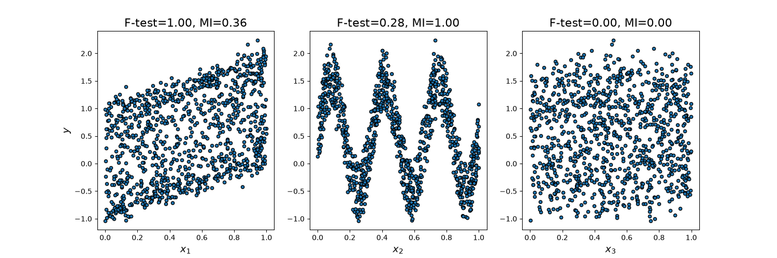
FILTER METHODS
Filter methods screen variables before model fitting
They are fast and transparent, but they test a variable mostly in isolation.
F-TEST SCREEN
Fⱼ = MS_between / MS_within
Both quantities are calculated for Xⱼ after grouping observations by Y. A large ratio means separation dominates within-group variation.
PARAMETER TO REPORT
k, percentile, or p-value threshold; define how many variables survive the screen.
READ THE FIGURE
The scikit-learn figure contrasts a linear pattern, a nonlinear pattern, and noise. A filter can detect association; it cannot establish causality or guarantee incremental out-of-sample value.
Machine Learning in Finance · Week 04 · NKUA MPhil Economics · 2026–2027
52
Notes:
Analytical comment for students: Filter methods. Use filters for an initial screen and data-quality diagnostics. The F-test compares between-group variation with within-group variation. The official figure shows why a linear F-test can miss a nonlinear pattern that mutual information detects. Source figure: scikit-learn, https://scikit-learn.org/stable/auto_examples/feature_selection/plot_f_test_vs_mi.html. The feature must represent information available at the prediction point and must be reproducible for future observations. Common mistake: Do not create a feature merely because it is easy to calculate.

Slide 53
ASSOCIATION SCREEN
A high univariate score is not the same as incremental value
Screening asks “does Xⱼ relate to y?”; the model asks “does Xⱼ add information after other features enter?”
PEARSON SCREEN
rⱼ = cov / (σXⱼσY)
The full definition is cov(Xⱼ,Y) divided by both sample standard deviations.
NUMERICAL READING
overdue_count has r = 0.398 here. That is a reason to investigate, not a final selection rule: correlation can miss nonlinear effects, interactions, and redundancy.
SELECTION CONSEQUENCE
Keep the screen as evidence. Decide on the final subset only after timing, redundancy, validation, and stability checks.
Machine Learning in Finance · Week 04 · NKUA MPhil Economics · 2026–2027
53
Notes:
Analytical comment for students: Association screen. Pearson correlation is rⱼ = cov(Xⱼ,Y)/(σXⱼσY): covariance divided by the two sample standard deviations. With a binary target, it is an orientation statistic and should not be confused with model discrimination or incremental predictive value. The feature must represent information available at the prediction point and must be reproducible for future observations. Common mistake: Do not create a feature merely because it is easy to calculate.

Slide 54
CORRELATION MATRIX
Use correlation to identify redundant feature families
Correlation is a map of shared movement, not a vote for or against a feature.
 | LIMIT | UTIL | BILL6 | PAY6 | OVER | MAX
LIMIT | 1.00 | -0.37 | 0.30 | 0.35 | -0.24 | -0.29
UTIL | -0.37 | 1.00 | 0.51 | -0.02 | 0.14 | 0.27
BILL6 | 0.30 | 0.51 | 1.00 | 0.34 | 0.01 | 0.10
PAY6 | 0.35 | -0.02 | 0.34 | 1.00 | -0.13 | -0.11
OVER | -0.24 | 0.14 | 0.01 | -0.13 | 1.00 | 0.76
MAX | -0.29 | 0.27 | 0.10 | -0.11 | 0.76 | 1.00
CORRELATION
rₐᵦ = Σᵢ(aᵢ − ā)(bᵢ − b̄) / √[Σᵢ(aᵢ − ā)² Σᵢ(bᵢ − b̄)²]
If |r| is large, investigate redundancy; do not delete a variable automatically.
Machine Learning in Finance · Week 04 · NKUA MPhil Economics · 2026–2027
54
Notes:
Analytical comment for students: Correlation matrix. The strongest relationships in this selected matrix are among delinquency summaries and among exposure summaries. A high pairwise correlation can make coefficient and importance interpretations unstable, so investigate the feature family and report the rule used to retain or merge variables. The feature must represent information available at the prediction point and must be reproducible for future observations. Common mistake: Do not create a feature merely because it is easy to calculate.

Slide 55
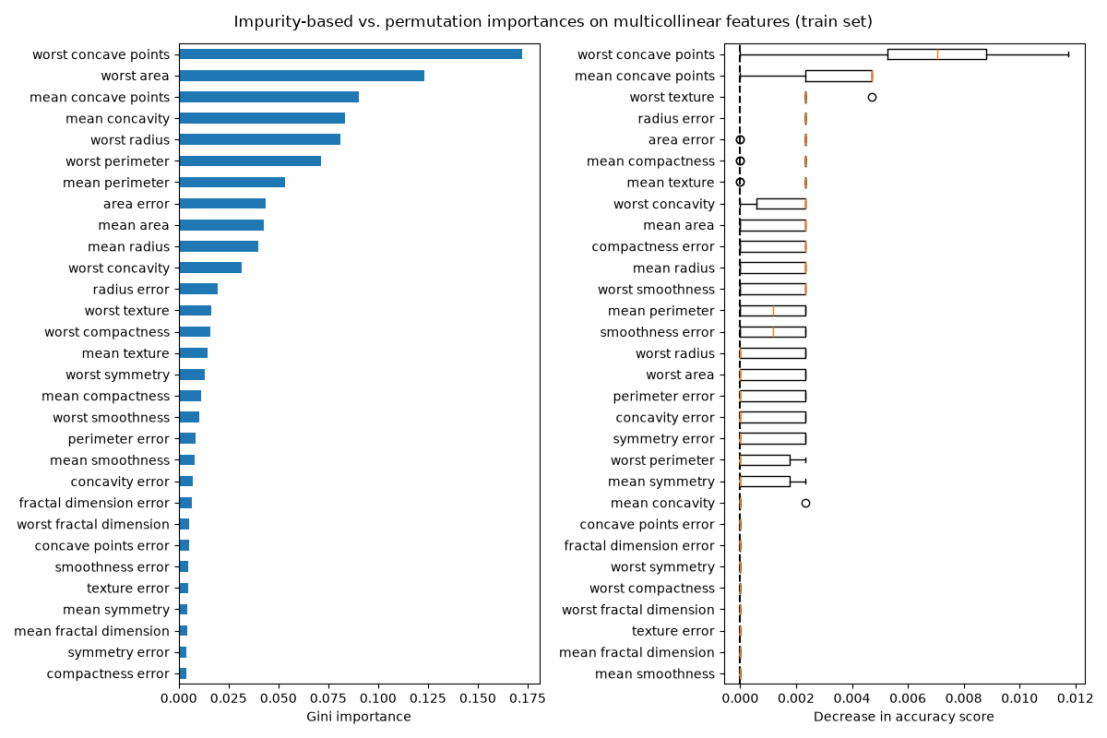
CORRELATION CLUSTERS
Importance must be read at the group level
When correlated features substitute for one another, shuffling one variable can leave the model with a proxy.
PERMUTATION IMPORTANCE
PIⱼ = M_base − M_perm(j)
If AUC falls from 0.74 to 0.70, PIⱼ = 0.04.
WHY CORRELATION MATTERS
If two variables carry almost the same signal, permuting one leaves the other available. A small single-variable drop does not prove the whole feature family is irrelevant.
PRACTICAL RESPONSE
Cluster correlated variables, permute groups, and report the group definition with the score.
Machine Learning in Finance · Week 04 · NKUA MPhil Economics · 2026–2027
55
Notes:
Analytical comment for students: Correlation clusters. Permutation importance compares a baseline model score with the score after one feature is shuffled. Correlated features can substitute for one another, so a low single-feature score can coexist with an important feature family. Source figure: scikit-learn, https://scikit-learn.org/stable/auto_examples/inspection/plot_permutation_importance_multicollinear.html. The feature must represent information available at the prediction point and must be reproducible for future observations. Common mistake: Do not create a feature merely because it is easy to calculate.

Slide 56
MUTUAL INFORMATION
Mutual information detects dependence beyond a straight line
The joint distribution is compared with the product of the marginal distributions. Natural logarithms give the result in nats.
DEFINITION
MI(X;Y) = Σₓ Σᵧ p(x,y) ln[ p(x,y) / (p(x)p(y)) ]
If p(x,y) = p(x)p(y) in every cell, MI = 0 and X and Y are independent.
X / Y | Y = 0 | Y = 1 | Row total
X = low | 0.40 | 0.10 | 0.50
X = high | 0.10 | 0.40 | 0.50
Column total | 0.50 | 0.50 | 1.00
WORKED CALCULATION
MI = 2×0.40 ln(0.40 / 0.25) + 2×0.10 ln(0.10 / 0.25)
= 0.193 nats
The joint table differs from the product of the margins, so the feature carries information about Y.
LIMITATION
Mutual information can detect nonlinear dependence, but its estimate can need more observations and still does not guarantee out-of-sample value.
Machine Learning in Finance · Week 04 · NKUA MPhil Economics · 2026–2027
56
Notes:
Analytical comment for students: Mutual information. The worked table has a higher default share for X = low than for X = high, so the joint distribution differs from independence. The value 0.193 is an illustrative natural-log calculation. scikit-learn notes that mutual-information estimates can need more samples than an F-test and can capture nonlinear dependence. The feature must represent information available at the prediction point and must be reproducible for future observations. Common mistake: Do not create a feature merely because it is easy to calculate.

Slide 57
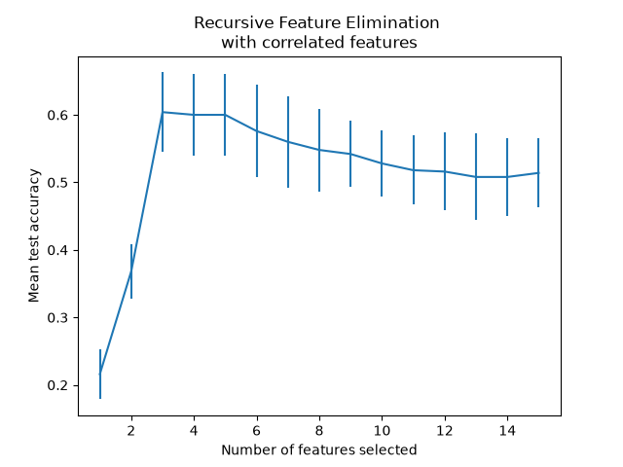
WRAPPER METHODS
Wrapper methods ask whether a subset improves a fitted model
Each candidate subset is evaluated by a validation score, so the method is flexible and expensive.
SEARCH OBJECTIVE
S* = argmaxₖ CVScore(Sₖ)
Sₖ is the subset retained at step k; each score must be evaluated on folds not used to fit that candidate.
RFE LOOP
1. Fit the estimator.
2. Rank feature importance.
3. Remove the weakest feature(s).
4. Repeat until the minimum is reached.
PARAMETERS AND READING
cv = 5, scoring = ROC-AUC, step = 1, minimum features = 3. The official curve favours 3, while nearby subsets remain close because correlated features can substitute.
Machine Learning in Finance · Week 04 · NKUA MPhil Economics · 2026–2027
57
Notes:
Analytical comment for students: Wrapper methods. Recursive feature elimination is a model-based search. The estimator, scoring metric, number of folds, removal step, and minimum subset size are parameters of the search. The official RFECV example uses a synthetic 15-feature classification task with three informative and two redundant features; the curve favours three selected features while remaining close for larger subsets. Source figure: scikit-learn, https://scikit-learn.org/stable/auto_examples/feature_selection/plot_rfe_with_cross_validation.html. The feature must represent information available at the prediction point and must be reproducible for future observations. Common mistake: Do not create a feature merely because it is easy to calculate.

Slide 58
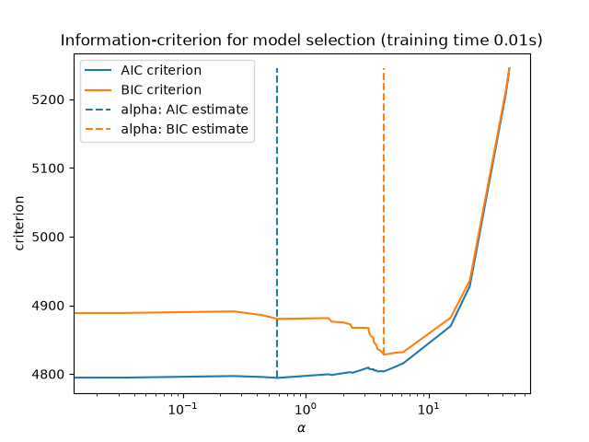
EMBEDDED METHODS
Embedded methods select while the model is fitted
Regularisation changes the objective; tree splits select variables as the tree grows.
LASSO OBJECTIVE
β̂(λ) = argminβ { −ℓ(β) + λΣⱼ|βⱼ| }
λ controls shrinkage. With sufficiently strong λ, some coefficients become exactly zero; under this convention, scikit-learn uses C = 1 / λ.
NUMERICAL READING
An illustrative fitted path may retain 5 non-zero coefficients at λ = 0.10 and 9 at λ = 0.01. The result depends on scaling, data, folds, and the penalty grid.
TREE-BASED ALTERNATIVE
A tree can select nonlinear split variables. max_depth and min_samples_leaf control complexity; impurity importance can favour high-cardinality or correlated predictors.
Machine Learning in Finance · Week 04 · NKUA MPhil Economics · 2026–2027
58
Notes:
Analytical comment for students: Embedded methods. Lasso uses an L1 penalty and can create sparse coefficients. The official scikit-learn figure shows information-criterion model selection across penalty values. Predictive hyperparameters should be tuned inside cross-validation, and the number of retained coefficients should be reported with the scaling and split design. Source figure: scikit-learn, https://scikit-learn.org/stable/auto_examples/linear_model/plot_lasso_model_selection.html. The feature must represent information available at the prediction point and must be reproducible for future observations. Common mistake: Do not create a feature merely because it is easy to calculate.

Slide 59
ELASTIC NET
Elastic Net balances sparsity with grouped information
The L1 part can set coefficients to zero; the L2 part discourages unstable large coefficients when predictors are correlated.
OBJECTIVE
β̂(λ, α) = argmin_{β₀,β} { −ℓ(β₀,β) + λ[ α‖β‖₁ + (1−α)(1/2)‖β‖₂² ] }
Use 0 ≤ α ≤ 1. Larger λ means stronger overall shrinkage; α controls the mixture.
Ridge
Elastic Net
Lasso
α = 0
α = 0.5
α = 1
Parameter | Meaning | Worked value
λ | Overall penalty strength | 0.10
α | L1 share of the penalty | 0.50
β = (0.8, 0.7) | ‖β‖₁ = 1.50; ‖β‖₂² = 1.13 | Penalty = 0.10325
Machine Learning in Finance · Week 04 · NKUA MPhil Economics · 2026–2027
59
Notes:
Analytical comment for students: Elastic Net. The penalty is fully written with native editable symbols. For β = (0.8, 0.7), ‖β‖₁ = 1.5 and ‖β‖₂² = 1.13. With λ = 0.1 and α = 0.5, the penalty contribution is 0.1[0.5(1.5) + 0.5(0.5)(1.13)] = 0.10325. In practice, λ and α are selected inside cross-validation after preprocessing is defined. The feature must represent information available at the prediction point and must be reproducible for future observations. Common mistake: Do not create a feature merely because it is easy to calculate.

Slide 60
REGULARISATION CODE
Tune the penalty inside the validation route
The grid is declared before the test result is read. The notebook should report both the winning settings and what the fitted model retained.
PYTHON
Record after fitting | Why it matters
best_params_ | Selected C and l1_ratio
best_score_ | Mean ROC-AUC across the five training folds
nonzero coefficients | How sparse the fitted representation is
validation design | How preprocessing and selection were kept inside folds
grid = {
'C': [0.01, 0.1, 1, 10],
'l1_ratio': [0.1, 0.5, 0.9]
}
search = GridSearchCV(
LogisticRegression(
penalty='elasticnet', solver='saga',
max_iter=2000
),
grid, scoring='roc_auc', cv=5, refit=True
)
search.fit(X_train, y_train)
PARAMETER MAP
C = 1 / λ under this convention. Smaller C means stronger regularisation; l1_ratio = α controls the Lasso–Ridge mix.
Machine Learning in Finance · Week 04 · NKUA MPhil Economics · 2026–2027
60
Notes:
Analytical comment for students: Regularisation code. In scikit-learn, C is the inverse of penalty strength. Standardisation should precede regularisation so coefficient magnitudes are comparable across variables. The number of non-zero coefficients is a fitted result, not a fixed property of Elastic Net. The grid and scoring rule must be declared before reading a held-out test result. The feature must represent information available at the prediction point and must be reproducible for future observations. Common mistake: Do not create a feature merely because it is easy to calculate.

Slide 61
SELECTION PIPELINE
Selection belongs inside the same pipeline as preprocessing
This is the information boundary that prevents validation labels from choosing the variables.
PYTHON
Stage | Training fold | Validation fold
Preprocess | Fit imputer / scaler | Apply frozen transform
Select | Choose columns from training labels | Apply selected columns
Model | Fit coefficients | Score only
Labels | Available to fit | Never choose features
pipe = Pipeline([
('prep', preprocessor),
('select', SelectFromModel(
LogisticRegression(
penalty='l1', solver='liblinear'
)
)),
('model', LogisticRegression(
penalty='elasticnet', solver='saga',
l1_ratio=0.5, max_iter=2000
))
])
INFORMATION BOUNDARY
Validation labels never choose features
Preprocessing, selection, and model fitting are all part of training.
Machine Learning in Finance · Week 04 · NKUA MPhil Economics · 2026–2027
61
Notes:
Analytical comment for students: Selection pipeline. Feature selection is part of model fitting. Fitting it before cross-validation allows validation labels or distributions to influence which variables survive. A safe pipeline learns preprocessing, selection, and model coefficients using only the training portion of each fold. The feature must represent information available at the prediction point and must be reproducible for future observations. Common mistake: Do not create a feature merely because it is easy to calculate.

Slide 62
STABILITY SELECTION
A selected feature should survive reasonable changes in the sample
Repeated validation records how often a feature is selected under a stated resampling design.
SELECTION FREQUENCY
πⱼ = (1 / B) Σᵦ₌₁ᴮ 𝟙(j ∈ Sᵦ)
πⱼ is a proportion, not a probability that a feature is universally correct.
WORKED COUNT
If B = 50 and a feature is selected 40 times, πⱼ = 40 / 50 = 0.80. A teaching approximation gives SE(πⱼ) ≈ √[0.8×0.2 / 50] = 0.0566.
INTERPRETATION
Correlated variables may exchange places. Report group-level frequency and the resampling design alongside the individual feature frequency.
Machine Learning in Finance · Week 04 · NKUA MPhil Economics · 2026–2027
62
Notes:
Analytical comment for students: Stability selection. The chart is an illustrative teaching output. Selection frequency is empirical evidence about persistence under the chosen folds, estimator, penalty grid, and sampling scheme. The binomial-style standard-error expression is only an approximation because resamples can be dependent. The feature must represent information available at the prediction point and must be reproducible for future observations. Common mistake: Do not create a feature merely because it is easy to calculate.

Slide 63
THREE FORMS OF STABILITY
Stability has three different clocks
Do not call every change “drift”: first identify what changed and when it could be observed.
DISTRIBUTION
RELATIONSHIP
OPERATIONS
Do the values of X move across lookback months or monitoring periods? Use plots, bins, and PSI.
Does X relate to Y in the same way after labels arrive? Use band rates, AUC, and coefficients.
Can the same feature still be produced with the same meaning and timing?
The next three slides use the real UCI six-month lookback to make change visible.
Machine Learning in Finance · Week 04 · NKUA MPhil Economics · 2026–2027
63
Notes:
Analytical comment for students: Three forms of stability. Distribution stability can be visualised from the six encoded UCI lookback columns. Relationship and operational stability need a labelled time panel and production metadata. The feature must represent information available at the prediction point and must be reproducible for future observations. Common mistake: Do not create a feature merely because it is easy to calculate.

Slide 64
MONTHLY VARIABLE DISTRIBUTION
For an input variable, monitor the distribution of fixed bins
These are monthly shares of resolved LendingClub loans in fixed revolving-utilisation bins. The bars answer: did the population move between bins?
VARIABLE PSI
Compare each month with the reference month using the same bin edges. The December shift produces PSI = 0.1992 versus January.
READ THE PLOT
A bar is a share of loans in a bin—not a default rate. Missing values are excluded from the displayed distribution and should be monitored separately.
Machine Learning in Finance · Week 04 · NKUA MPhil Economics · 2026–2027
64
Notes:
Analytical comment for students: Monthly variable distribution. Variable PSI uses input distributions, so it can be computed when the inputs arrive. The reference sample, fixed bin edges, missing-value policy, and monthly sample sizes must remain unchanged for a meaningful comparison. Source dataset: https://github.com/akshayr89/Lending-Club---Exploratory-Data-Analysis/blob/master/loan.csv. The feature must represent information available at the prediction point and must be reproducible for future observations. Common mistake: Do not create a feature merely because it is easy to calculate.

Slide 65
MONTHLY CATEGORICAL DISTRIBUTION
For a categorical input, monitor category shares
Grade is an origination category. The chart shows composition change, not a target-rate distribution.
WHAT CHANGED
The relative mix of grades changes across issue months; that can move portfolio risk even when a variable’s raw scale is unchanged.
CONTROL
Do not convert a composition shift into a causal claim. Recheck sample selection, missingness, and whether the category definition stayed stable.
Machine Learning in Finance · Week 04 · NKUA MPhil Economics · 2026–2027
65
Notes:
Analytical comment for students: Monthly categorical distribution. Categorical PSI or a category-share table is computed from the same idea as numeric-bin PSI. Keep the category universe and treatment of unseen or missing categories explicit. Source dataset: https://github.com/akshayr89/Lending-Club---Exploratory-Data-Analysis/blob/master/loan.csv. The feature must represent information available at the prediction point and must be reproducible for future observations. Common mistake: Do not create a feature merely because it is easy to calculate.

Slide 66
MONTHLY TARGET RATE
A target-driven jump must be read with its denominator
The line shows later observed outcomes. The highlighted change is evidence to investigate, not a current model input and not proof of a single cause.
TARGET-DRIVEN JUMP
2011-11 → 2011-12: +4.5 pp
BAD-RATE MATHEMATICS
BRₘ = Bₘ / Nₘ · ΔBRₘ = BRₘ − BRₘ₋₁ · SE(BRₘ) ≈ √[BRₘ(1−BRₘ)/Nₘ]
December: 423 defaults / 2,042 resolved loans = 20.7%; relative change from 2011-11 = 27.5%.
Machine Learning in Finance · Week 04 · NKUA MPhil Economics · 2026–2027
66
Notes:
Analytical comment for students: Monthly target rate. Target monitoring is delayed until the outcome is known. The line connects the observed monthly rates, the circles identify the observations, and the labels report every rate in percent. The December jump is ΔBR = BR_2011-12 − BR_2011-11, equal to 4.5 percentage points and 27.5% relative in this source slice. Investigate borrower mix, sample maturity, reporting changes, macro stress, and other documented events before making a causal claim. This is an eventual resolved-loan rate, not a one-month forward PD. Source dataset: https://github.com/akshayr89/Lending-Club---Exploratory-Data-Analysis/blob/master/loan.csv. The feature must represent information available at the prediction point and must be reproducible for future observations. Common mistake: Do not create a feature merely because it is easy to calculate.

Slide 67
PSI WORKED EXAMPLE
PSI is a sum of transparent bin-level contributions
The sign of qⱼ − pⱼ tells us whether a bin grew or shrank. The logarithm scales that change by the relative share.
POPULATION STABILITY INDEX
PSIⱼ = (qⱼ − pⱼ) × ln(qⱼ / pⱼ) and PSI = Σⱼ PSIⱼ
pⱼ = reference share; qⱼ = monitoring share. Use the same fixed bins and handle zero shares with a documented small ε.
Bin | pⱼ | qⱼ | qⱼ − pⱼ | ln(qⱼ / pⱼ) | PSIⱼ
0–25% | 0.40 | 0.32 | −0.08 | −0.2231 | 0.0178
25–50% | 0.30 | 0.34 | +0.04 | +0.1252 | 0.0050
50–80% | 0.20 | 0.22 | +0.02 | +0.0953 | 0.0019
>80% | 0.10 | 0.12 | +0.02 | +0.1823 | 0.0036
Total | 1.00 | 1.00 |  |  | 0.0283
The total is 0.0283 using unrounded logarithms; rounded display cells can sum to 0.0284.
Machine Learning in Finance · Week 04 · NKUA MPhil Economics · 2026–2027
67
Notes:
Analytical comment for students: PSI worked example. For the first bin, q − p = 0.32 − 0.40 = −0.08 and ln(q / p) = ln(0.32 / 0.40) = −0.2231. Their product is positive: (−0.08)(−0.2231) = 0.0178. Add all bin contributions to obtain PSI ≈ 0.0283. A total PSI must state the reference period, monitoring period, fixed bin edges, zero-share policy, and sample sizes. The feature must represent information available at the prediction point and must be reproducible for future observations. Common mistake: Do not create a feature merely because it is easy to calculate.

Slide 68
PSI CODE
The same PSI function monitors variables and a binary target
The object changes: an explanatory variable uses fixed value bins; a target uses the two shares “good” and “bad” after labels mature.
PYTHON
def psi(p, q):
eps = 1e-6
p = np.asarray(p, dtype=float)
q = np.asarray(q, dtype=float)
return np.sum((q-p) * np.log((q+eps)/(p+eps)))
monthly_share = pd.crosstab(
loans['issue_month'], loans['util_bin'], normalize='index'
)
variable_psi = monthly_share.apply(
lambda row: psi(monthly_share.iloc[0], row), axis=1
)
ref_bad = default_rate.iloc[0]
target_psi = default_rate.apply(
lambda r: psi([1-ref_bad, ref_bad], [1-r, r])
)
VARIABLE PSI
Fixed bins turn X into shares pⱼ and qⱼ. The calculation can run when the inputs arrive, before any target label is available.
TARGET PSI
For a binary target, compare [good share, bad share] between periods. A target-rate line remains the clearest primary plot; target PSI is a summary after labels mature.
Machine Learning in Finance · Week 04 · NKUA MPhil Economics · 2026–2027
68
Notes:
Analytical comment for students: PSI code. The code treats an explanatory variable as a row of fixed-bin shares. For the target, a binary rate r becomes the two-category distribution [1 − r, r]. Target PSI is delayed until labels are mature and should be reported with the target-rate time series, denominators, and outcome definition. The feature must represent information available at the prediction point and must be reproducible for future observations. Common mistake: Do not create a feature merely because it is easy to calculate.

Slide 69
RELATIONSHIP STABILITY
A stable feature distribution can still have a changing target relationship
The same utilization band can have a different default rate in another period or segment.
Check | Development | Monitoring | Interpretation
Band distribution | Share by utilization band | Share by utilization band | Input drift
Target rate | Default rate within band | Default rate within band | Relationship drift
Model contribution | Coefficient or importance | Coefficient or importance | Role drift
TIMING
Target rates require labels. They are monitoring evidence after the target horizon, not features for the original prediction.
Machine Learning in Finance · Week 04 · NKUA MPhil Economics · 2026–2027
69
Notes:
Analytical comment for students: Relationship stability. The UCI lookback plots show changing inputs, but relationship stability requires labels by real monitoring period or segment. Keep the two questions separate. The feature must represent information available at the prediction point and must be reproducible for future observations. Common mistake: Do not create a feature merely because it is easy to calculate.

Slide 70
TARGET MONITORING
Input monitoring can act now; target monitoring must wait
The label-maturity boundary separates signals available at data receipt from signals available only after the outcome window closes.
INPUT LANE
LABEL MATURITY
t: inputs arrive
t: variable PSI
TARGET LANE
t: snapshot
t+1: outcome window
after labels: target PSI
Signal | Available when | Action
Utilization distribution | At data receipt | Variable PSI / missingness check
Default rate | After t+1 labels close | Target-rate and target-PSI monitoring
Default rate by band | After labels close | Relationship-stability check
Machine Learning in Finance · Week 04 · NKUA MPhil Economics · 2026–2027
70
Notes:
Analytical comment for students: Target monitoring. Variable PSI can be computed when inputs arrive. Target PSI and relationship stability require later target labels. The two lanes make the information boundary explicit: a future target rate can monitor a model, but it cannot become an input for the original prediction. The feature must represent information available at the prediction point and must be reproducible for future observations. Common mistake: Do not create a feature merely because it is easy to calculate.

Slide 71
OPERATIONAL STABILITY
A mathematically valid feature can be operationally invalid
Production monitoring must check whether the same raw inputs arrive with the same meaning.
Operational question | Example failure
Availability | PAY_AMT1 arrives two days late
Latency | A bureau field is not available at decision time
Definition | A status code changes meaning after a system release
Missingness | A new source system leaves a field empty
Reproducibility | The feature code differs between training and scoring
Machine Learning in Finance · Week 04 · NKUA MPhil Economics · 2026–2027
71
Notes:
Analytical comment for students: Operational stability. A feature is deployable only when it is measurable with the same definition, timing, and data-quality policy as during training. The feature must represent information available at the prediction point and must be reproducible for future observations. Common mistake: Do not create a feature merely because it is easy to calculate.

Slide 72
UCI LIMITATION
The teaching data cannot prove temporal drift
The UCI file contains six months of history encoded as columns but does not provide a complete event-time panel.
WHAT THE DATA CAN SHOW
WHAT REQUIRES NEW DATA
Feature construction, subgroup associations, target balance, denominator policies, interactions, and leakage-safe code patterns.
Month-by-month distribution drift, target-rate drift, production availability, and post-deployment stability.
ANALYTICAL DISCIPLINE
Do not label a cross-sectional subgroup comparison as temporal stability. State the data limitation and provide the code needed for a real panel.
Machine Learning in Finance · Week 04 · NKUA MPhil Economics · 2026–2027
72
Notes:
Analytical comment for students: UCI limitation. Good analysis distinguishes evidence from a teaching example. The Week 4 notebook is explicit about which claims the source can and cannot support. The feature must represent information available at the prediction point and must be reproducible for future observations. Common mistake: Do not create a feature merely because it is easy to calculate.

Slide 73
EVENT MONITORING
Monitoring combines data-driven and target-driven events
The monitoring table keeps current input events separate from later outcome events.
Monitoring item | Type | When observed | Action
utilization distribution | Data-driven | At scoring or data receipt | Check input drift
recent overdue share | Data-driven | At scoring or data receipt | Check population stress
default rate | Target-driven | After the target window | Check outcome drift
default rate by utilization band | Target-driven | After labels arrive | Check relationship drift
field availability | Operational | Before scoring | Stop or route missing data
Machine Learning in Finance · Week 04 · NKUA MPhil Economics · 2026–2027
73
Notes:
Analytical comment for students: Event monitoring. The distinction determines when a signal becomes available. Input monitoring can act before labels arrive, while target monitoring is delayed by the outcome horizon. The feature must represent information available at the prediction point and must be reproducible for future observations. Common mistake: Do not create a feature merely because it is easy to calculate.

Slide 74
MONITORING CODE
The code should preserve the event timestamp and target timestamp
A monitoring table should not collapse current inputs and later outcomes into one undated table.
PYTHON
input_event = (
utilization >= 0.80
)
# after the target window
target_event = default_next_month == 1
monitor = (
data.groupby('period')
.agg(input_event_rate=('input_event','mean'),
target_event_rate=('target_event','mean'))
)
INTERPRETATION
The two rates can move at different times. Input stress may rise before the target rate changes because the target is observed later.
Machine Learning in Finance · Week 04 · NKUA MPhil Economics · 2026–2027
74
Notes:
Analytical comment for students: Monitoring code. Event monitoring must retain period and timestamp fields. Without them, the analyst cannot tell whether a change is a current input shift or a delayed outcome shift. The feature must represent information available at the prediction point and must be reproducible for future observations. Common mistake: Do not create a feature merely because it is easy to calculate.

Slide 75
PART 7
Leakage-safe implementation
75
The final feature table must be numerically safe, temporally valid, and reviewable.
Machine Learning in Finance
75
Notes:
Analytical comment for students: Leakage-safe implementation. The final feature table must be numerically safe, temporally valid, and reviewable. The feature must represent information available at the prediction point and must be reproducible for future observations. Common mistake: Do not create a feature merely because it is easy to calculate.

Slide 76
NUMERIC AUDIT
Derived variables create new quality risks
The raw-table audit does not prove that the engineered matrix is safe.
Check | Question | Evidence
Zero denominators | Did any ratio divide by zero? | Count and policy
Infinity | Did a transformation create ±∞? | isfinite check
Missingness | Did lags or ratios create NaN? | Missingness by feature
Tails | Did a few values dominate the scale? | Quantiles and affected rows
Units | Are ratios, currency, counts, and logs labelled? | Feature dictionary
Machine Learning in Finance · Week 04 · NKUA MPhil Economics · 2026–2027
76
Notes:
Analytical comment for students: Numeric audit. A feature can be syntactically correct and numerically unsafe. Check the derived matrix after construction and before model fitting. The feature must represent information available at the prediction point and must be reproducible for future observations. Common mistake: Do not create a feature merely because it is easy to calculate.

Slide 77
LEAKAGE AUDIT
Every feature needs an information-boundary test
The audit asks whether any target, future event, or full-sample fitted parameter entered the value.
Leakage source | Example | Control
Future event | Payment after t | As-of filter
Target value | default_next_month | Exclude target from X
Full-sample statistic | Median or quantile from all rows | Fit on training rows
Target encoding | Category default rate from all labels | Fit inside CV
Entity overlap | Same client in train and test | Group or time split
Machine Learning in Finance · Week 04 · NKUA MPhil Economics · 2026–2027
77
Notes:
Analytical comment for students: Leakage audit. Leakage is a design failure rather than a model failure. The correct control depends on the source: time filter, exclusion, fit-on-training, target encoding pipeline, or group split. The feature must represent information available at the prediction point and must be reproducible for future observations. Common mistake: Do not create a feature merely because it is easy to calculate.

Slide 78
FEATURE MATRIX AUDIT
The final matrix must stay aligned with the target
Shape, row identity, and source lineage are as important as the formula.
PYTHON
assert X.shape[0] == y.shape[0]
assert X.index.equals(y.index)
finite_rate = np.isfinite(
X.select_dtypes('number')
).mean()
missing_rate = X.isna().mean().sort_values(
ascending=False
)
REQUIRED EVIDENCE
Row count, index alignment, missingness, infinity checks, feature units, and the raw columns used for every derived variable.
Machine Learning in Finance · Week 04 · NKUA MPhil Economics · 2026–2027
78
Notes:
Analytical comment for students: Feature matrix audit. A row-alignment error can create a model that appears to run while pairing the wrong features with the wrong target. The feature must represent information available at the prediction point and must be reproducible for future observations. Common mistake: Do not create a feature merely because it is easy to calculate.

Slide 79
DOCUMENTATION
The feature dictionary is part of the model
A reviewer should be able to trace a feature from its name to the raw data and financial mechanism.
Field | Example: utilization
Feature name | utilization
Definition | BILL_AMT1 / LIMIT_BAL
Raw inputs | BILL_AMT1, LIMIT_BAL
Unit | Ratio
Timing | Available at snapshot t
Zero policy | Zero limit becomes missing
Evidence | Bands, target rates, stability, leakage check
Machine Learning in Finance · Week 04 · NKUA MPhil Economics · 2026–2027
79
Notes:
Analytical comment for students: Documentation. A feature dictionary is model governance evidence. It helps the analyst, reviewer, and future maintainer challenge an invalid assumption before deployment. The feature must represent information available at the prediction point and must be reproducible for future observations. Common mistake: Do not create a feature merely because it is easy to calculate.

Slide 80
WEEKLY ASSIGNMENT
The deliverable is a documented feature table
Submit the executed Colab notebook one day before the next course meeting.
Use the complete UCI table and state the observation unit, target, prediction point, and source.
Construct utilization, overdue_count_6m, payment_to_bill_6m, recent_overdue, one change, and one interaction.
Add one transformed monetary variable and justify the transformation.
Provide at least three plots or grouped summaries with account counts.
Write a feature contract for every selected variable.
Demonstrate one leakage failure and one safe implementation.
Separate descriptive association from causal language.
EVIDENCE
Code, outputs, plots, data dictionary, and analytical interpretation.
Machine Learning in Finance · Week 04 · NKUA MPhil Economics · 2026–2027
80
Notes:
Analytical comment for students: Weekly assignment. The notebook is assessed on reasoning as well as code. A correct expression without timing, units, and interpretation is incomplete. The feature must represent information available at the prediction point and must be reproducible for future observations. Common mistake: Do not create a feature merely because it is easy to calculate.

Slide 81
SCORECARD BRIDGE
Binning and WOE convert a variable into a scorecard-ready representation
The transformation is supervised because the bins are judged by how they separate good and bad outcomes.
Stage | Who or what acts | Output
Candidate cuts | Analyst, domain rule, or decision tree | Potential thresholds
Training-only evaluation | Code using training labels | Bad rate, WOE, IV by bin
Governance review | Analyst and risk owner | Merged bins, monotonicity, minimum size
Transformation | Feature pipeline | WOE value for each approved bin
Model fitting | Logistic regression | Scorecard coefficients and points
Machine Learning in Finance · Week 04 · NKUA MPhil Economics · 2026–2027
81
Notes:
Analytical comment for students: Scorecard bridge. A scorecard binning procedure is not an automatic truth machine. An algorithm proposes candidates, while the analyst and governance process decide whether the bins are meaningful, stable, and operationally acceptable. The feature must represent information available at the prediction point and must be reproducible for future observations. Common mistake: Do not create a feature merely because it is easy to calculate.

Slide 82
WHO CREATES THE BINS
The bins are created by an algorithm and reviewed by an analyst
A production scorecard normally combines statistical evidence with domain and governance constraints.
DOMAIN OR POLICY CUT
DECISION-TREE CUT
GOVERNED FINAL BIN
An analyst may require 0–25%, 25–50%, and >50% because the bands have a clear business interpretation.
A shallow tree can propose thresholds that reduce class impurity in the training sample.
The risk analyst reviews sample size, monotonicity, stability, missingness, and operational meaning before approving or merging bins.
TRAINING RULE
All target-driven binning decisions are fitted on the training sample or training fold only.
Machine Learning in Finance · Week 04 · NKUA MPhil Economics · 2026–2027
82
Notes:
Analytical comment for students: Who creates the bins. The computer searches candidate thresholds, but the final scorecard transformation is a governed modelling decision. The analyst owns the definition, constraints, and documentation. The feature must represent information available at the prediction point and must be reproducible for future observations. Common mistake: Do not create a feature merely because it is easy to calculate.

Slide 83
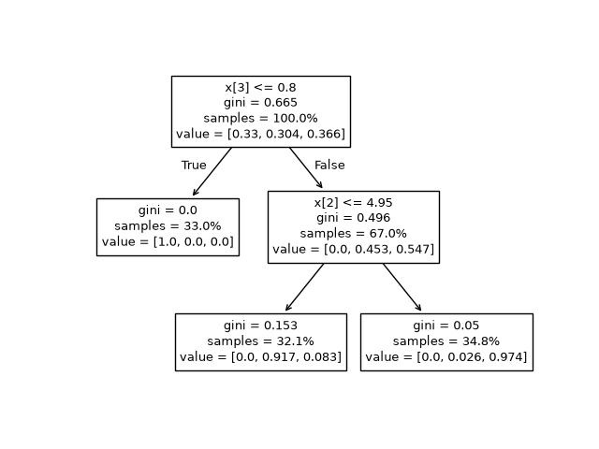
DECISION-TREE ANATOMY
A tree proposes supervised cut points by reducing child impurity
At each node, candidate thresholds are scored with the training labels. The lowest weighted child impurity wins, subject to tree constraints.
READ A NODE
Split rule → sample count → class counts → Gini. A leaf is not “true”; it is a small region of the training sample with an estimated class mix.
WEIGHTED SPLIT
G_split = (n_L / n_t)G(L) + (n_R / n_t)G(R)
Choose the candidate with the largest ΔG = G(t) − G_split.
Candidate cut | Left child | Right child | G_split | ΔG
A: x < 50 | 4 good / 1 bad | 2 good / 3 bad | 0.40 | 0.08
B: x < 70 | 5 good / 0 bad | 1 good / 4 bad | 0.16 | 0.32
WORKED PARENT
Parent = 6 good + 4 bad, so G(t) = 1 − (0.6² + 0.4²) = 0.48. Candidate B wins because 0.48 − 0.16 = 0.32.
Machine Learning in Finance · Week 04 · NKUA MPhil Economics · 2026–2027
83
Notes:
Analytical comment for students: Decision-tree anatomy. Read the official figure from root to leaves. In the worked example, the parent has 6 good and 4 bad loans, so G(t) = 0.48. Candidate A has child impurities 0.32 and 0.48, giving 0.40 after weighting and gain 0.08. Candidate B gives 0.16 after weighting and gain 0.32, so B is preferred in the training sample. A production tree still needs minimum leaf size, depth control, validation, and governance review before its cuts become scorecard bins. Source figure: scikit-learn, https://scikit-learn.org/stable/auto_examples/tree/plot_unveil_tree_structure. The feature must represent information available at the prediction point and must be reproducible for future observations. Common mistake: Do not create a feature merely because it is easy to calculate.

Slide 84
GINI IMPURITY
Gini measures class mixing inside a node
For a node t, pₖ|t is the share of class k among the nₜ observations reaching that node. Lower impurity means a purer node.
NODE IMPURITY
pₖ|t = (1 / nₜ) Σᵢ∈t 𝟙(yᵢ = k) and G(t) = 1 − Σₖ pₖ|t²
For two classes, G(t) = 1 − [p(good|t)² + p(bad|t)²].
Composition | Substitution | Gini | Reading
100% good | 1 − (1.00² + 0.00²) | 0.00 | Pure
50% good / 50% bad | 1 − (0.50² + 0.50²) | 0.50 | Maximum mixing
80% good / 20% bad | 1 − (0.80² + 0.20²) | 0.32 | Partly separated
SPLIT RULE
G_split = (n_L / n_t)G(L) + (n_R / n_t)G(R); choose the candidate with the largest ΔG = G(t) − G_split.
Machine Learning in Finance · Week 04 · NKUA MPhil Economics · 2026–2027
84
Notes:
Analytical comment for students: Gini impurity. For the 80/20 node, 1 − (0.8² + 0.2²) = 0.32. The curve is symmetric because swapping good and bad does not change class mixing. This is a tree-splitting criterion, not the classifier Gini derived from AUC. The feature must represent information available at the prediction point and must be reproducible for future observations. Common mistake: Do not create a feature merely because it is easy to calculate.

Slide 85
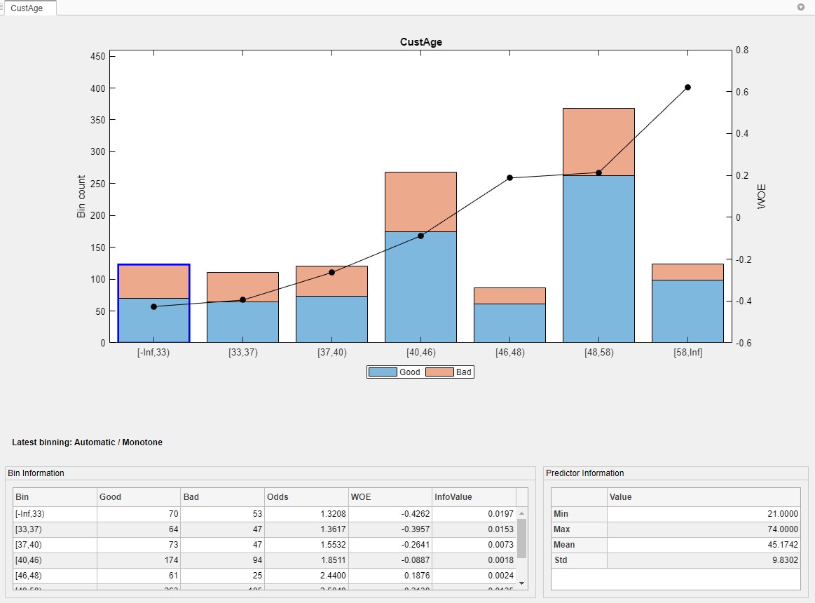
WOE TRANSFORMATION
WOE tells us which bins contain relatively more good or bad accounts
Use Good = non-default and Bad = default in this worked example. Fit the lookup on training labels, then freeze it for validation and test rows.
Bin | GoodShareⱼ | BadShareⱼ | WOEⱼ | Meaning
A | 0.3424 | 0.0753 | +1.5139 | More good mass
B | 0.6576 | 0.9247 | −0.3408 | More bad mass
WEIGHT OF EVIDENCE
WOEⱼ = ln(GoodShareⱼ / BadShareⱼ)
WHAT THE IMAGE SHOWS
Positive WOE: GoodShare > BadShare. Negative WOE: BadShare > GoodShare.
The bars are counts by outcome; the WOE line summarizes the relative distribution. It is an illustration of the mechanics, not the UCI sample.
ZERO-COUNT CONTROL
If a bin has zero good or bad observations, the logarithm is undefined. Merge the bin or apply a documented smoothing rule before calculating WOE.
Machine Learning in Finance · Week 04 · NKUA MPhil Economics · 2026–2027
85
Notes:
Analytical comment for students: WOE transformation. For bin A, WOE = ln(0.3424 / 0.0753) = +1.5139: the bin contains a larger share of all good accounts than of all bad accounts. For bin B, WOE = ln(0.6576 / 0.9247) = −0.3408: the bin contains a larger share of all bad accounts. The external figure illustrates the same idea but is not calculated from the UCI data. Source figure: MathWorks Binning Explorer case study, https://www.mathworks.com/help/risk/binning-explorer-case-study.html. The feature must represent information available at the prediction point and must be reproducible for future observations. Common mistake: Do not create a feature merely because it is easy to calculate.

Slide 86
INFORMATION VALUE
IV adds the evidence contribution from every approved bin
Each bin contributes distribution difference × WOE. The total is a univariate scorecard measure, not out-of-sample model performance.
INFORMATION VALUE
IV = Σⱼ (GoodShareⱼ − BadShareⱼ) × WOEⱼ
The contribution is non-negative because the difference and WOE have the same sign.
Bin | GoodShare − BadShare | WOE | Contribution
A | 0.3424 − 0.0753 = +0.2671 | +1.5139 | 0.4043
B | 0.6576 − 0.9247 = −0.2671 | −0.3408 | 0.0910
Total IV |  |  | 0.4953
INTERPRETATION
For bin A, (+0.2671)(+1.5139) = 0.4043. Sum the rows after bins are approved; then test leakage, sample size, monotonicity, redundancy, and stability.
Machine Learning in Finance · Week 04 · NKUA MPhil Economics · 2026–2027
86
Notes:
Analytical comment for students: Information Value. For bin A, the contribution is (0.3424 − 0.0753) × 1.5139 = 0.4043. For bin B, (−0.2671)(−0.3408) = 0.0910. The total IV is 0.4953 in this illustrative two-bin example. A large IV can reflect leakage, rare-bin overfitting, or unstable behaviour; it is not incremental model performance. The feature must represent information available at the prediction point and must be reproducible for future observations. Common mistake: Do not create a feature merely because it is easy to calculate.

Slide 87
INFORMATION VALUE AND INFORMATION COEFFICIENT
These two abbreviations answer different questions
Information Value belongs to binned scorecard analysis; Information Coefficient is commonly used for cross-sectional financial forecasts. Do not interchange them.
Metric | Full mathematics | Object and use
Information Value (IV) | IV = Σⱼ (GoodShareⱼ − BadShareⱼ) × WOEⱼ | Binned predictor versus binary outcome; univariate scorecard evidence
Information Coefficient (IC) | ICₜ = ρₛ(ŝᵢ,ₜ, rᵢ,ₜ₊₁) = corr(rank(ŝᵢ,ₜ), rank(rᵢ,ₜ₊₁)) | Cross-sectional predictions versus next-period realised returns
Model Gini | Gini_model = 2 × AUC − 1 | Whole binary classifier discrimination
Tree Gini impurity | G(t) = 1 − Σₖ(pₖ|t)² | Class mixing inside one decision-tree node
INTERPRETATION
IV is not IC. IV is not model Gini. State the object, outcome horizon, and sample used with every metric.
Machine Learning in Finance · Week 04 · NKUA MPhil Economics · 2026–2027
87
Notes:
Analytical comment for students: Information Value and Information Coefficient. For a scorecard, IV measures how a binned variable separates good and bad distributions. In portfolio research, IC is often a Spearman rank correlation between a cross-sectional signal at t and next-period return at t+1. The two metrics are not substitutes and should never be compared on the same scale. The feature must represent information available at the prediction point and must be reproducible for future observations. Common mistake: Do not create a feature merely because it is easy to calculate.

Slide 88
RECENT OVERDUE EVENT
A current event can be evaluated against a later target
The recent-overdue indicator is defined from the snapshot and evaluated using the following-month outcome.
NO RECENT OVERDUE
13.8% across 23,182 accounts.
RECENT OVERDUE
50.3% across 6,818 accounts.
Machine Learning in Finance · Week 04 · NKUA MPhil Economics · 2026–2027
88
Notes:
Analytical comment for students: Recent overdue event. This is a clean example of the distinction between event and target: PAY_0 defines the current data-driven event, while default_next_month provides the later target-driven outcome. The feature must represent information available at the prediction point and must be reproducible for future observations. Common mistake: Do not create a feature merely because it is easy to calculate.

Slide 89
TAKE-HOME CHECKLIST
Before submitting the notebook
Use this checklist to inspect the final feature table.
Check | Pass condition
Prediction problem | Unit, target, horizon, and cutoff are written
Feature definition | Formula, raw inputs, unit, and timing are recorded
Financial meaning | Each feature answers a stated question
Numeric safety | Zeros, missingness, infinity, and tails are checked
Temporal safety | Lags and rolling windows are backward-looking
Selection safety | Feature selection occurs inside validation
Stability | Distribution, relationship, and operational checks are discussed
Communication | Plots show counts and careful interpretation
Machine Learning in Finance · Week 04 · NKUA MPhil Economics · 2026–2027
89
Notes:
Analytical comment for students: Take-home checklist. The checklist turns feature engineering into an auditable process. Students should be able to answer every question without opening the model code. The feature must represent information available at the prediction point and must be reproducible for future observations. Common mistake: Do not create a feature merely because it is easy to calculate.

Slide 90
SUMMARY
Week 4 in one page
Raw financial fields become useful predictors only when their meaning, timing, selection, and stability are explicit.
Define the prediction point and separate current data-driven events from future target-driven events.
Use ratios, counts, changes, lags, rolling summaries, interactions, and transformations to represent financial mechanisms.
Treat feature selection as model fitting and keep target-driven transformations inside cross-validation.
Check distribution stability, relationship stability, and operational availability before deployment.
Document every feature so the next analyst can reproduce and challenge it.
The final question is simple: what does this variable mean, and when could we have known it?
Machine Learning in Finance · Week 04 · NKUA MPhil Economics · 2026–2027
90
Notes:
Analytical comment for students: Week 4 summary. A credible feature is financially meaningful, available at the prediction point, selected through a controlled validation process, stable enough for its intended use, and documented for reproduction.

